Slide 1

Final Year Project
Family Medical History Management Application
Presented By:
Muhammad Sohail Sabir (FA19-BCS-016)
Sana Sabir (FA19-BCS-058)
Supervised By:
Sir Muhammad Abdullah
COMSATS University Islamabad Vehari Campus

Slide 2

Introduction
A Family Medical History Management Application is an android application through which a patient can maintain and manage his own and his family’s health information.
With this application, patients can save all their medical data including:
Doctor visits.
Lab test results.
Diagnosis history of any particular illness.
Prescriptions

Slide 3

Objectives
Help the patient easily
Maintain and manage his and his family’s medical records.
Share his medical record with another person.
access all health details in one place whenever you are necessary.
Help the doctor
Identify whether a patient has a higher risk for a disease.
Recommend treatments or other options to reduce a patient’s risk of disease.

Slide 4
Significance
Properly collected medical records can identify whether a patient has a higher risk for a disease, help the health care practitioner recommend treatments or other options to reduce a patient’s risk of disease, and help to plan lifestyle changes to keep the patient well.
Our system provides the best way to maintain and manage the patient medical records.

Slide 5

Features of Application

Slide 6

Main Features of Application
Save the user’s personal medical records e.g. Medicines, Prescriptions, Lab Reports, and Vaccinations

Slide 7

Main features of Application
Add Family Members and save their medical records e.g. Medicines, Prescriptions, Lab Reports, and Vaccinations

Slide 8

Main Features of Application
Schedule their appointments
Notification-based reminders about appointments

Slide 9

Main Features of Application
Share any record.

Slide 10

Main Features of Application
Search for another person to request their medical records

Slide 11

Development Tools
Tools and Technologies | Tools | Rationale
 | Android Studio | IDE
 | Flutter | Framework
 | Dart | Programming Language
 | Firebase | Database
 | Flutter Inspector | Debugging and inspecting UI
 | Git | Version control system for source code

Slide 12

User Interface

Slide 13
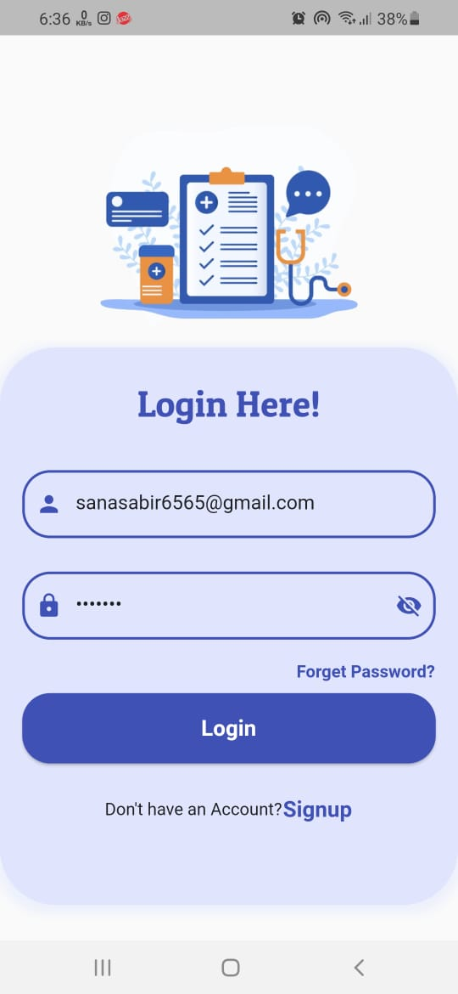
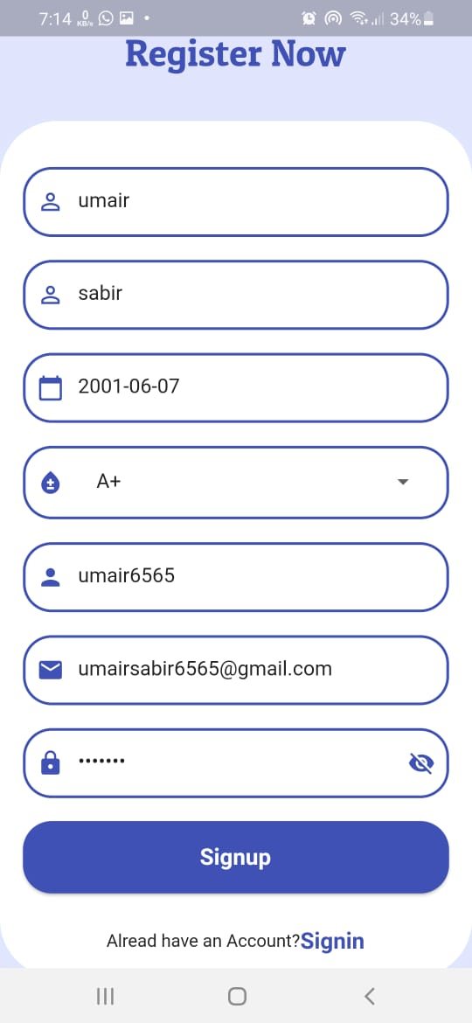
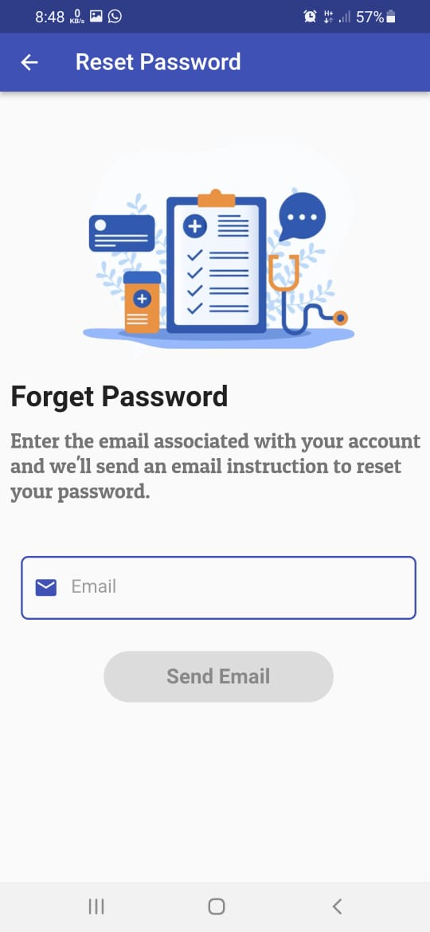
Login, signup and forget password screen

Slide 14
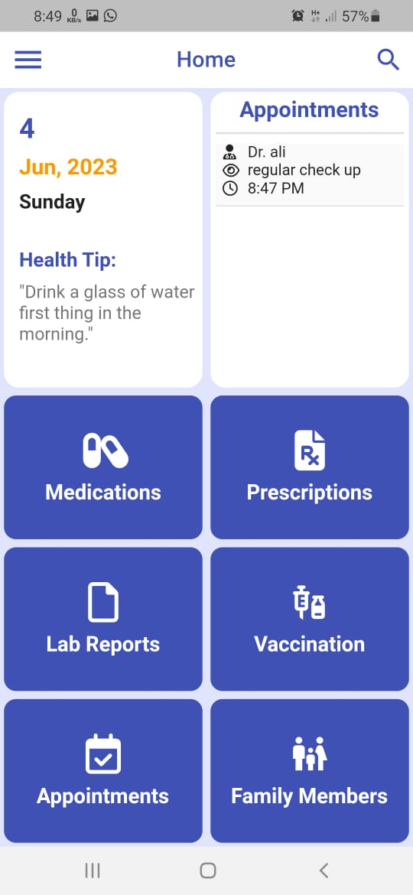
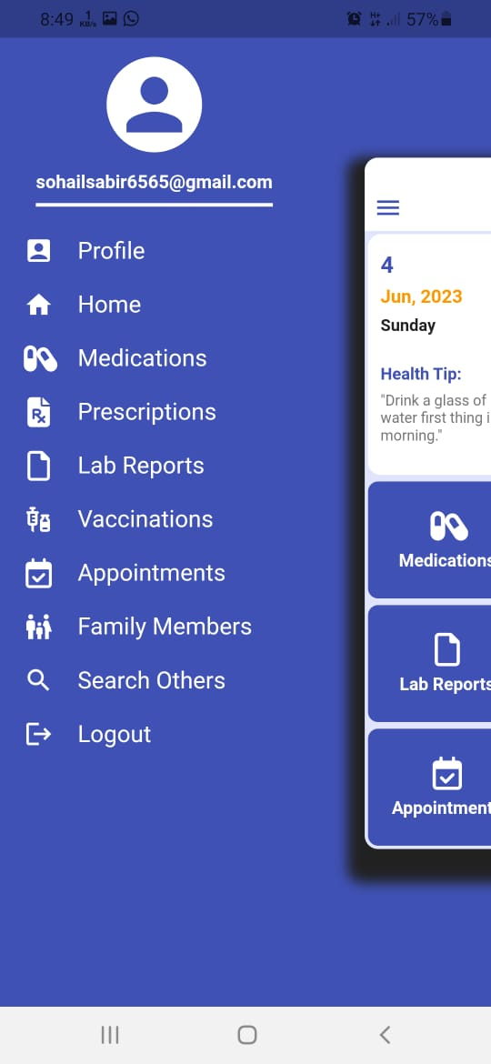
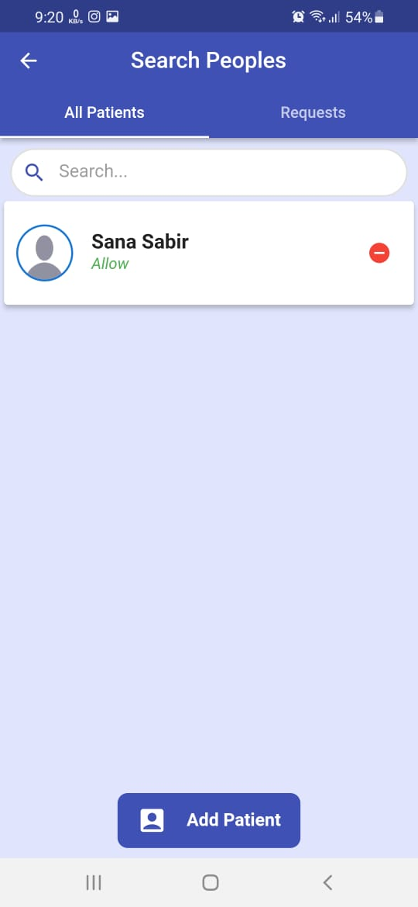
Home, menu, and search screen

Slide 15
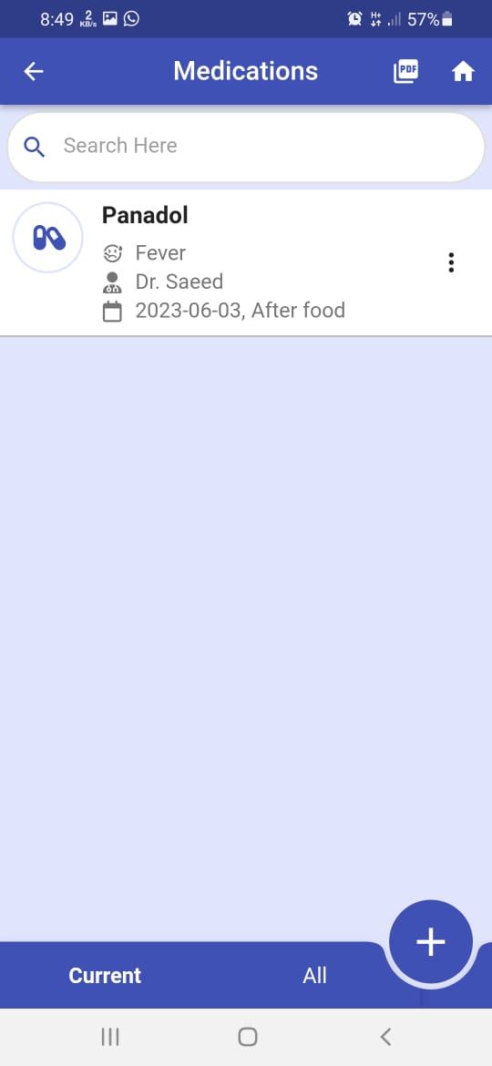
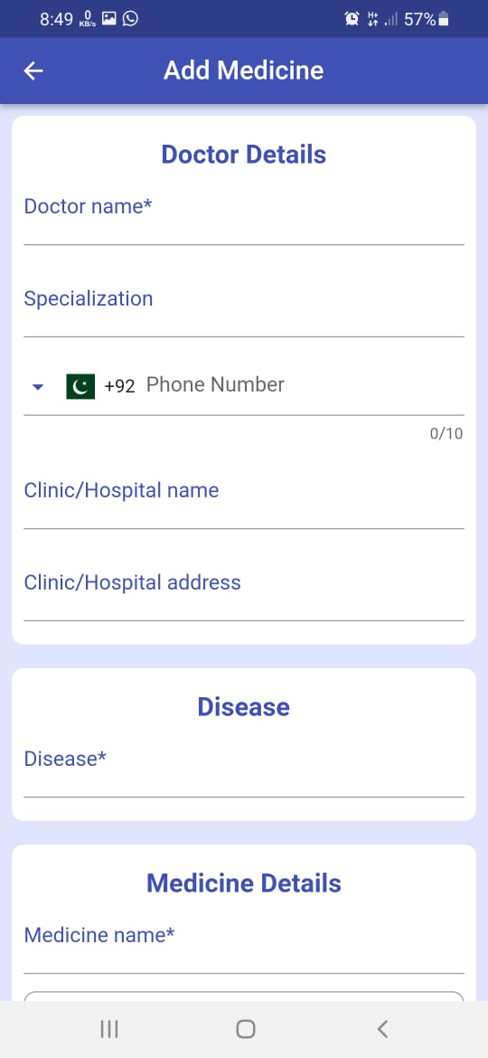
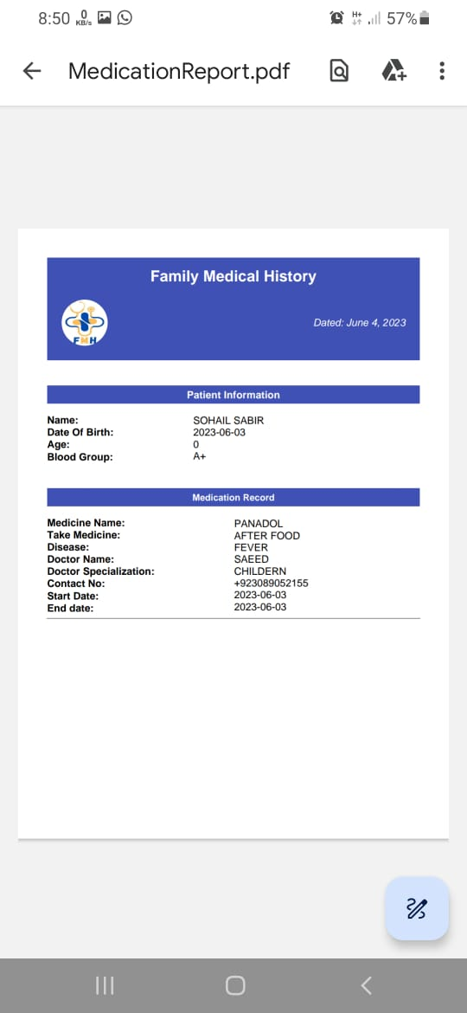
Medication screens

Slide 16
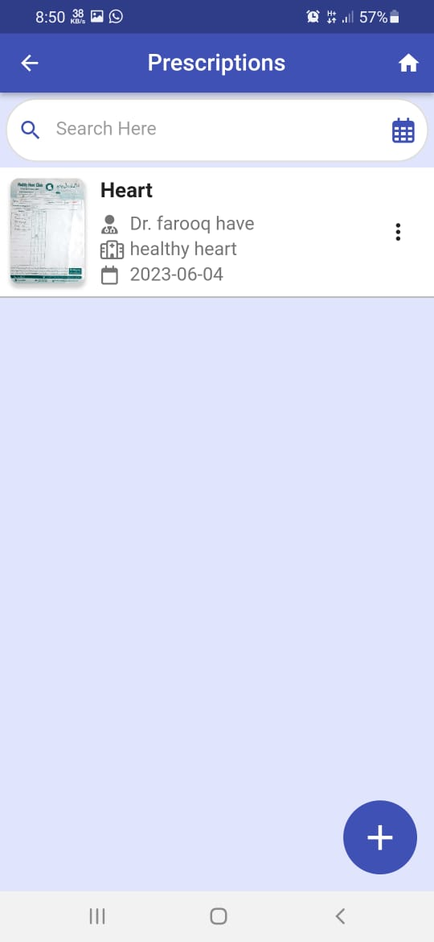
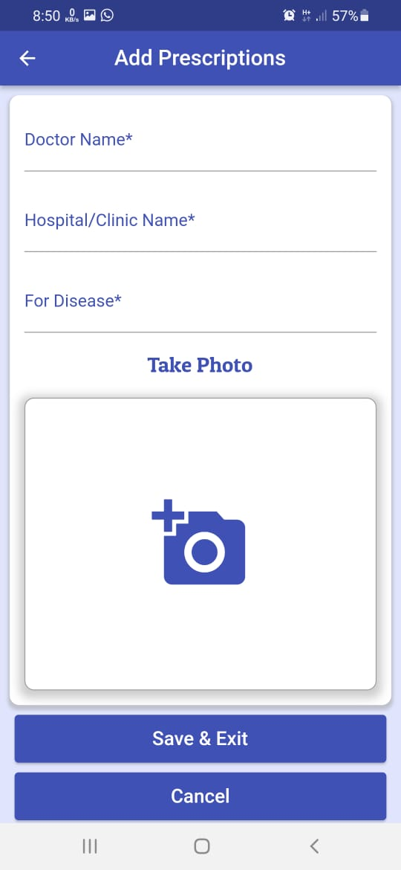
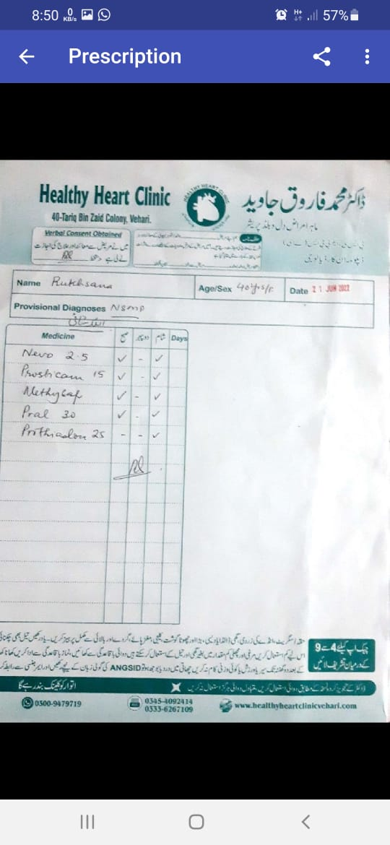
Prescription Screens

Slide 17
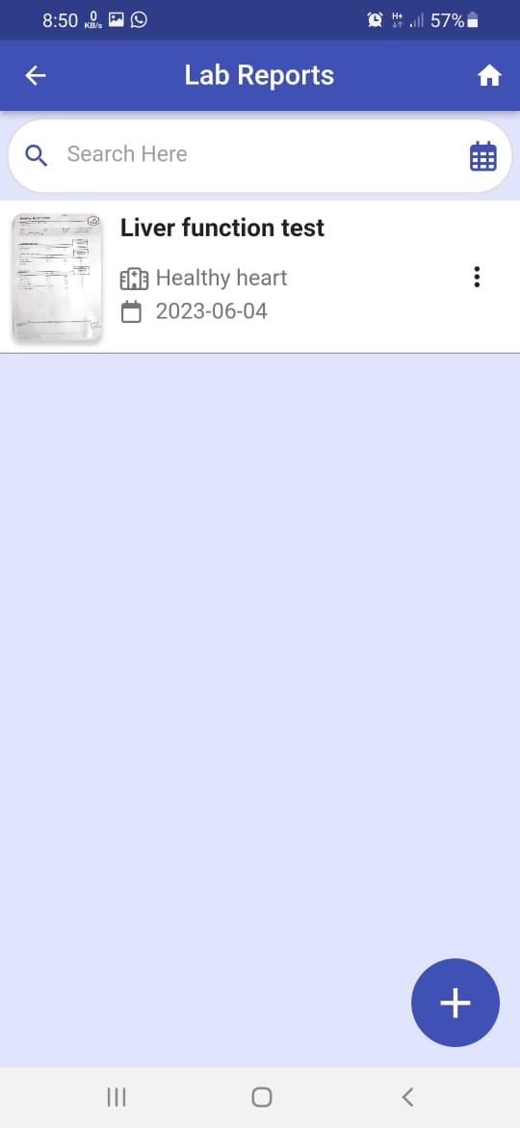
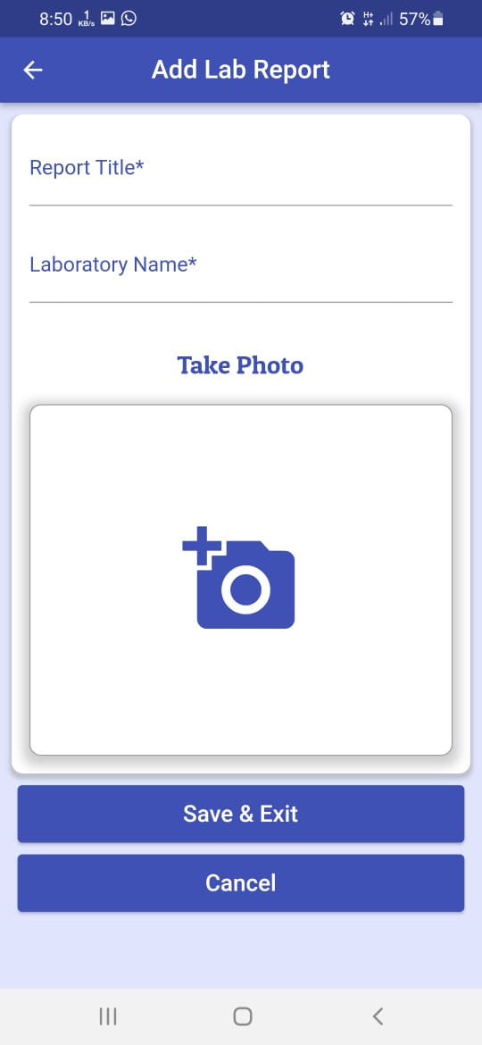
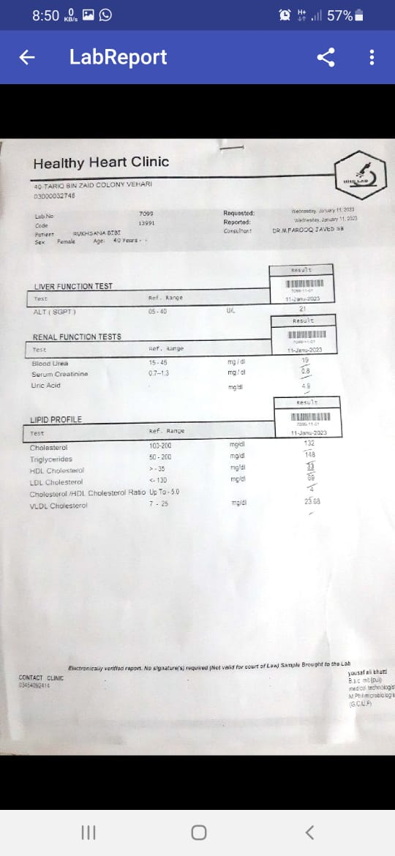
Lab Report screens

Slide 18
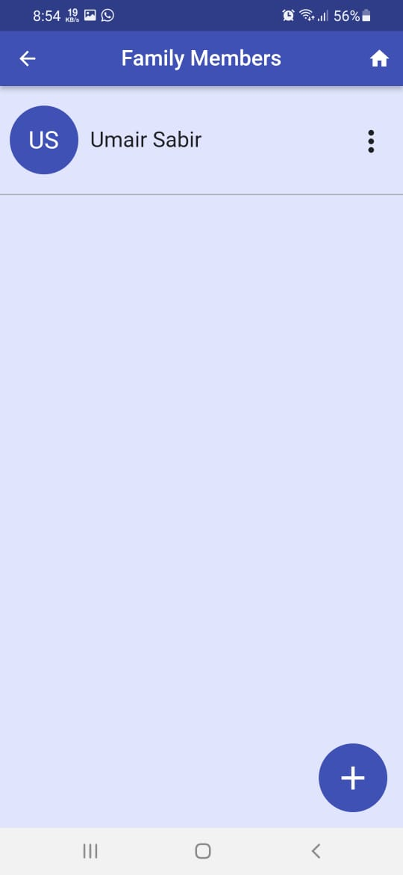
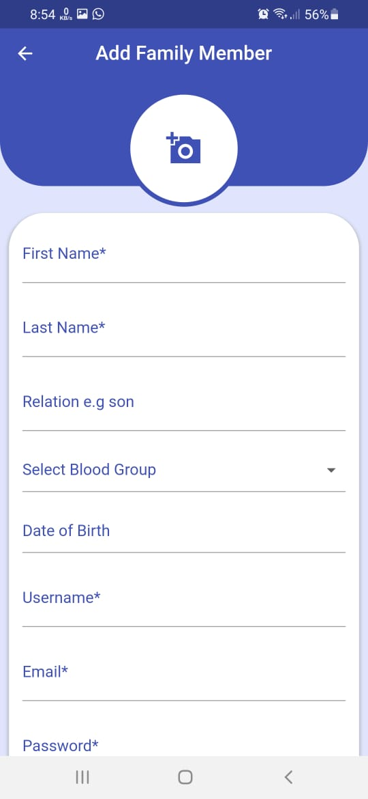
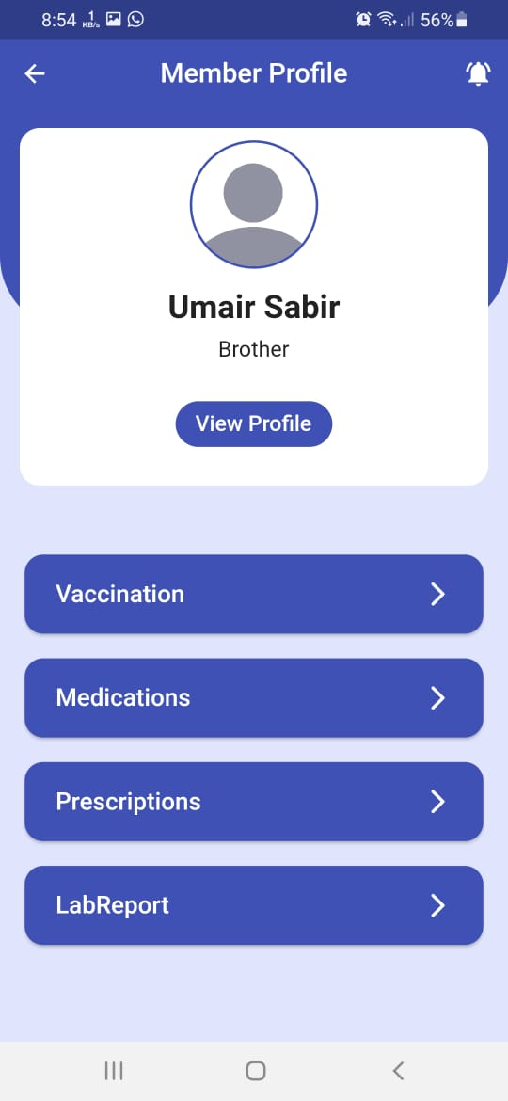
Family Members Screens

Slide 19
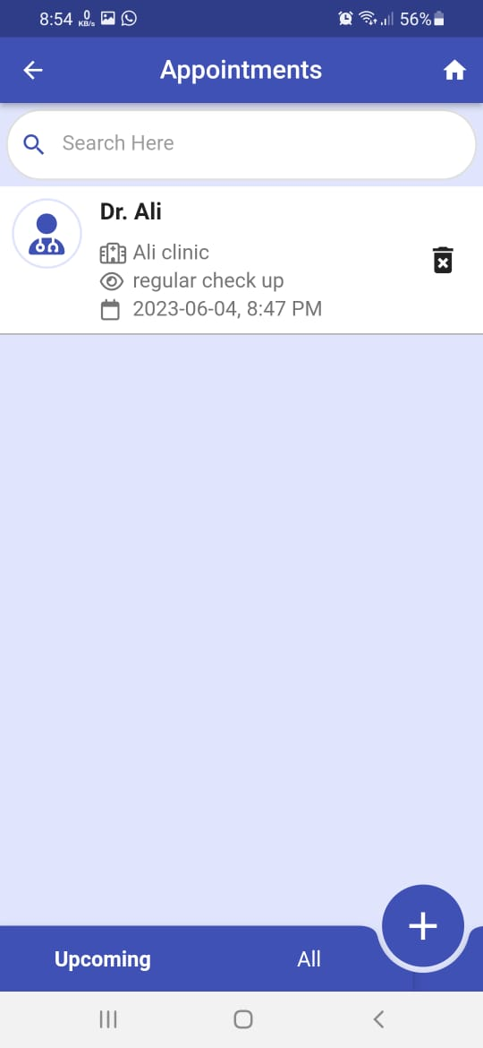
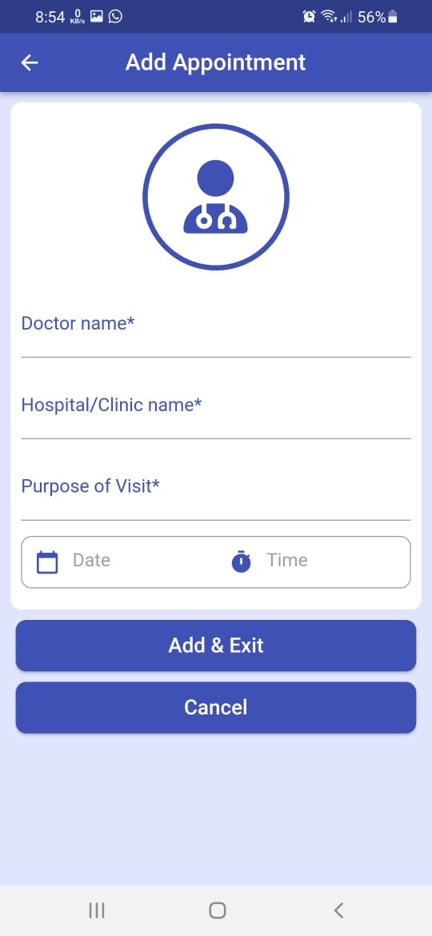
Appointments screens

Slide 20
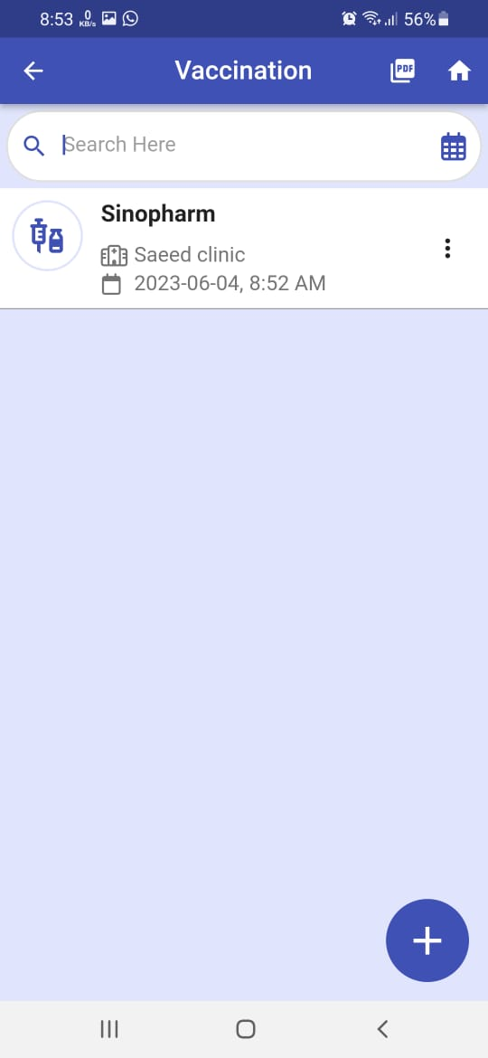
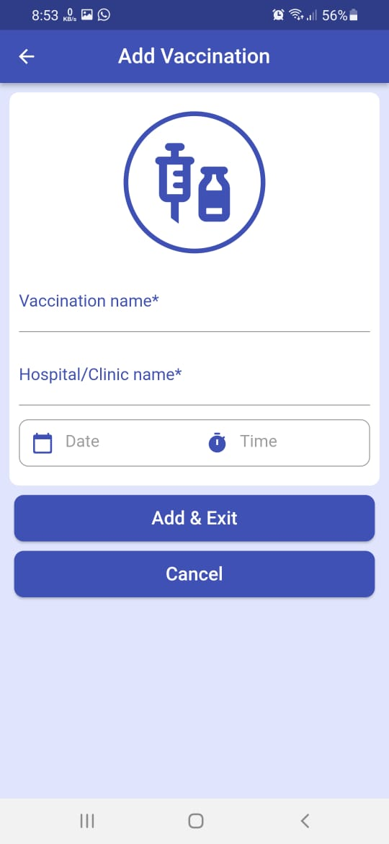
Vaccination screens

Slide 21
Operating Environment
Software Requirements
Hardware Requirement
Operating System: Android
Minimum version: 8.0
RAM: 2GB
Storage Space: 200 MB
Network: Working internet connection.

Slide 22
Future work
In future we may add chat and call option for user to contact with other users.

Slide 23
THANKS

